Slide 1
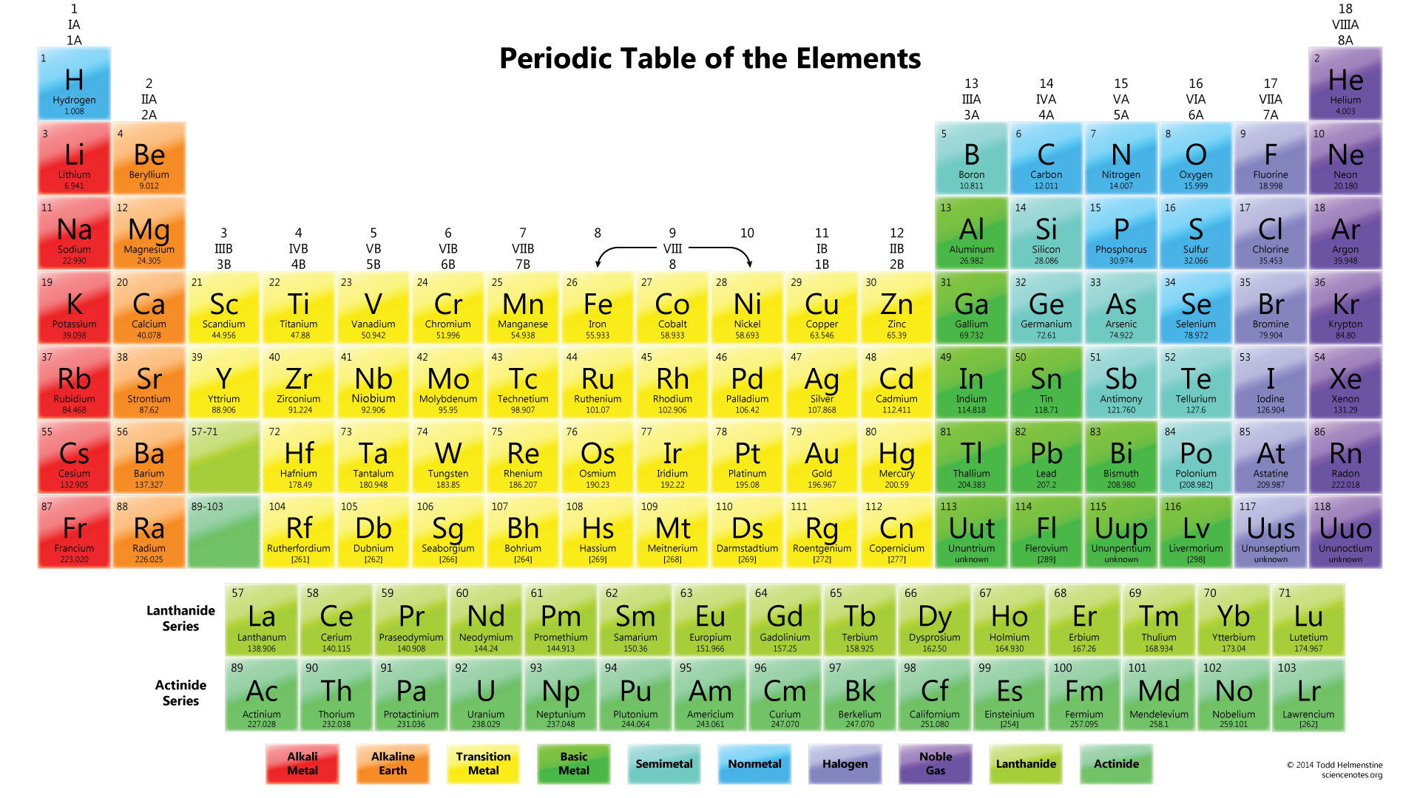

Slide 2
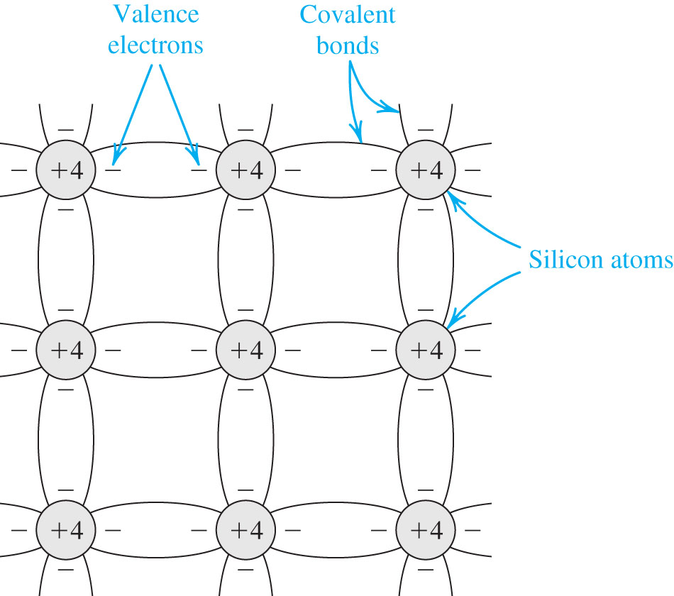
Figure 3.1 Two-dimensional representation of the silicon crystal. The circles represent the inner core of silicon atoms, with +4 indicating its positive charge of +4q, which is neutralized by the charge of the four valence electrons. Observe how the covalent bonds are formed by sharing of the valence electrons. At 0 K, all bonds are intact and no free electrons are available for current conduction.

Slide 3
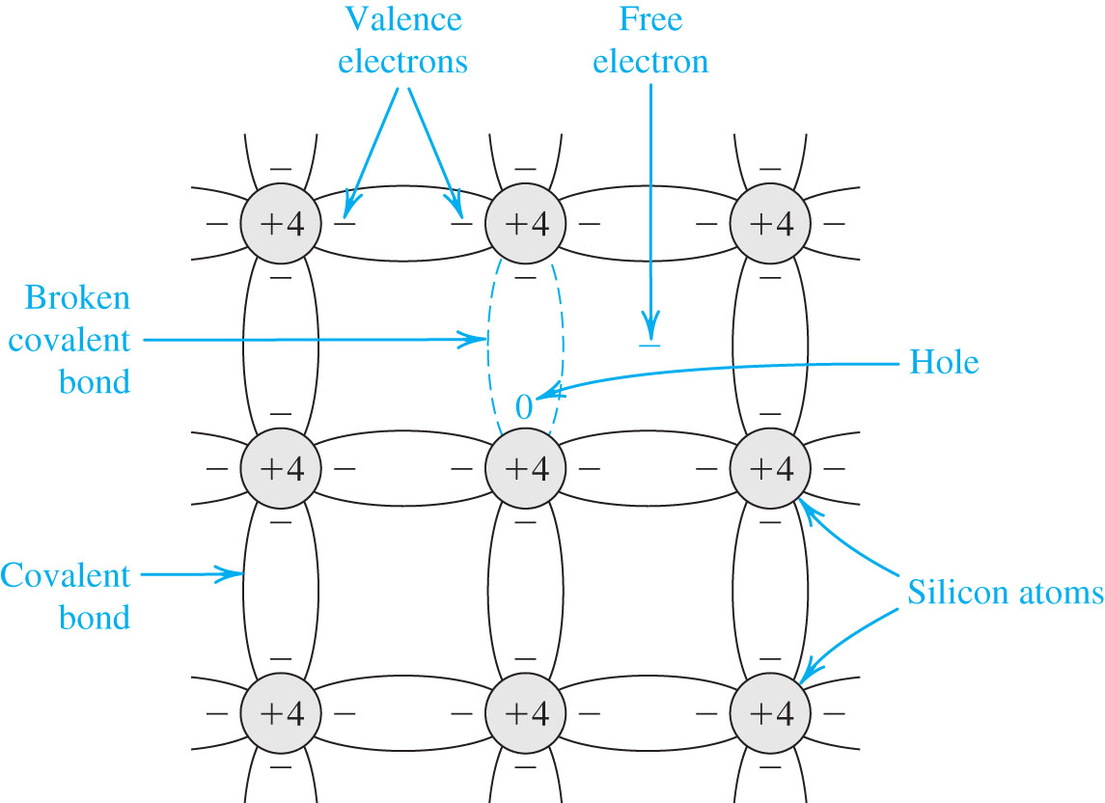
Figure 3.2 At room temperature, some of the covalent bonds are broken by thermal generation. Each broken bond gives rise to a free electron and a hole, both of which become available for current conduction.

Slide 4
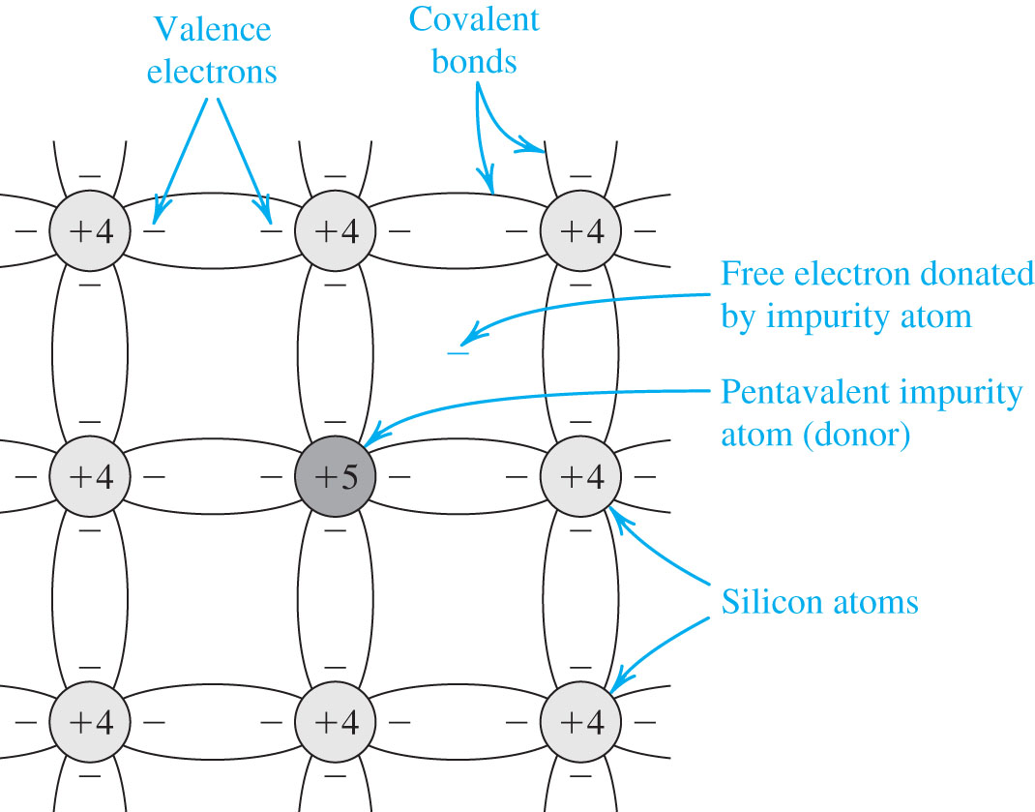
Figure 3.3 A silicon crystal doped by a pentavalent element. Each dopant atom donates a free electron and is thus called a donor. The doped semiconductor becomes n type.

Slide 5
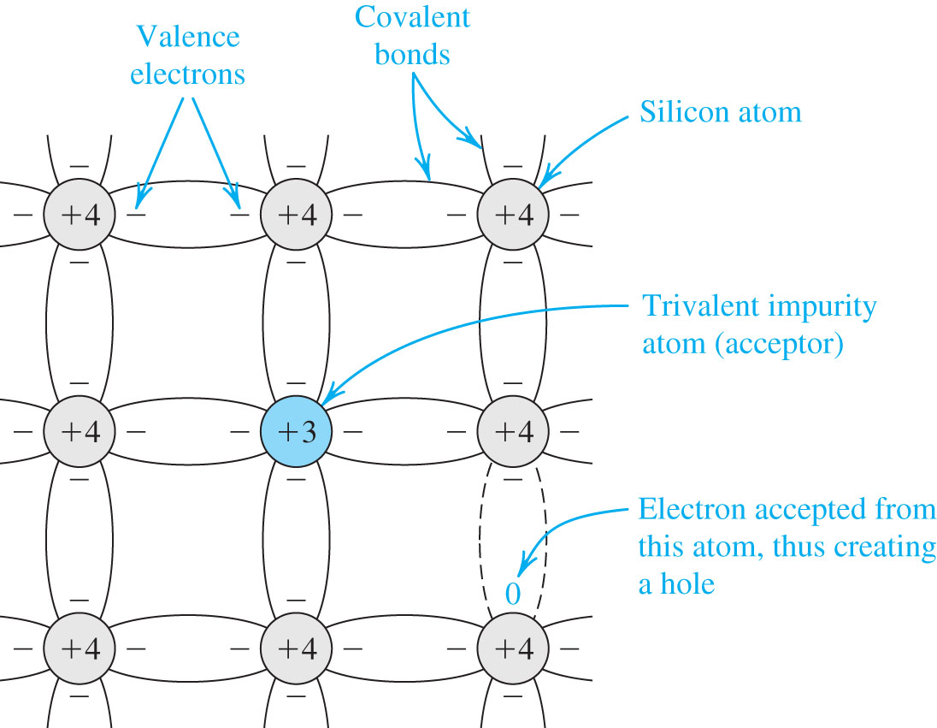
Figure 3.4 A silicon crystal doped with boron, a trivalent impurity. Each dopant atom gives rise to a hole, and the semiconductor becomes p type.

Slide 6
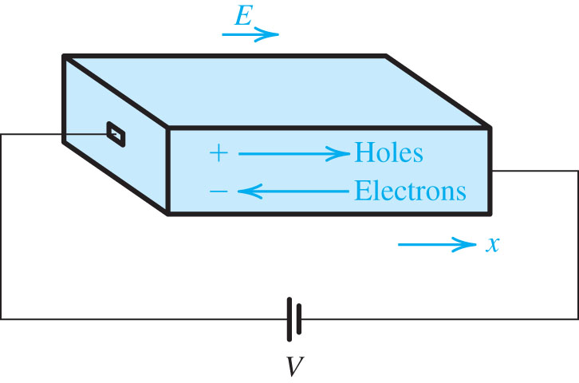
Figure 3.5 An electric field E established in a bar of silicon causes the holes to drift in the direction of E and the free electrons to drift in the opposite direction. Both the hole and electron drift currents are in the direction of E.

Slide 7
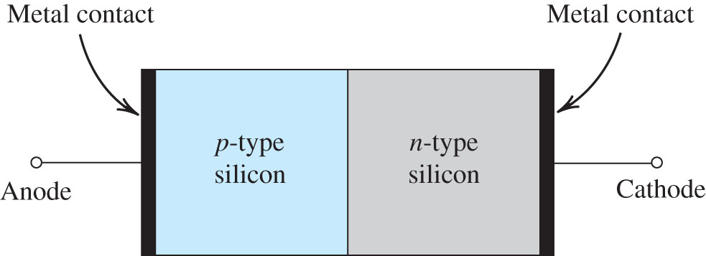
Figure 3.8 Simplified physical structure of the pn junction. (Actual geometries are given in Appendix A.) As the pn junction implements the junction diode, its terminals are labeled anode and cathode.

Slide 8
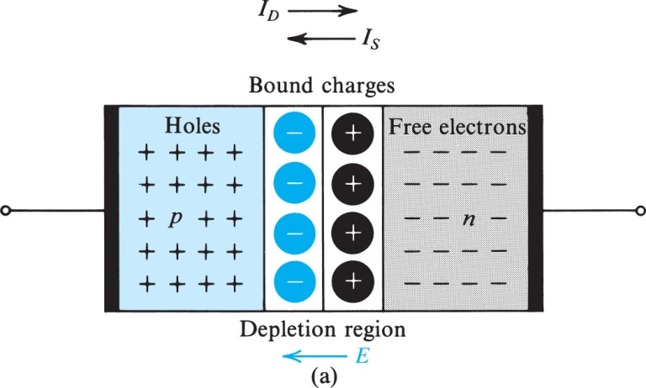
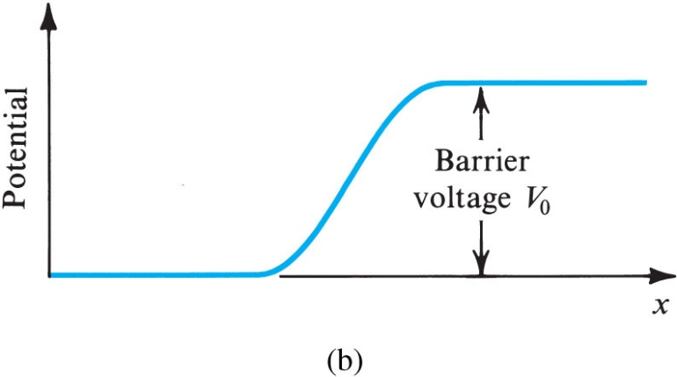
Figure 3.9 (a) The pn junction with no applied voltage (open-circuited terminals). (b) The potential distribution along an axis perpendicular to the junction.

Slide 9
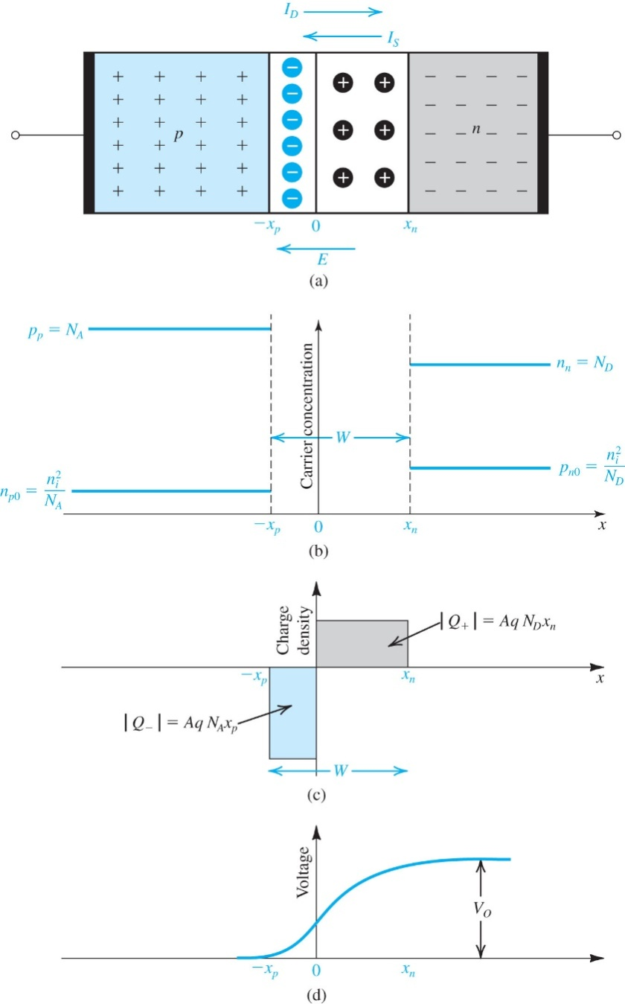
Figure 3.10 (a) A pn junction with the terminals open-circuited. (b) Carrier concentrations; note that N_{A} > N_{D}. (c) The charge stored in both sides of the depletion region; Q_{J} = |Q₊| = |Q₋|. (d) The built-in voltage V₀.

Slide 10
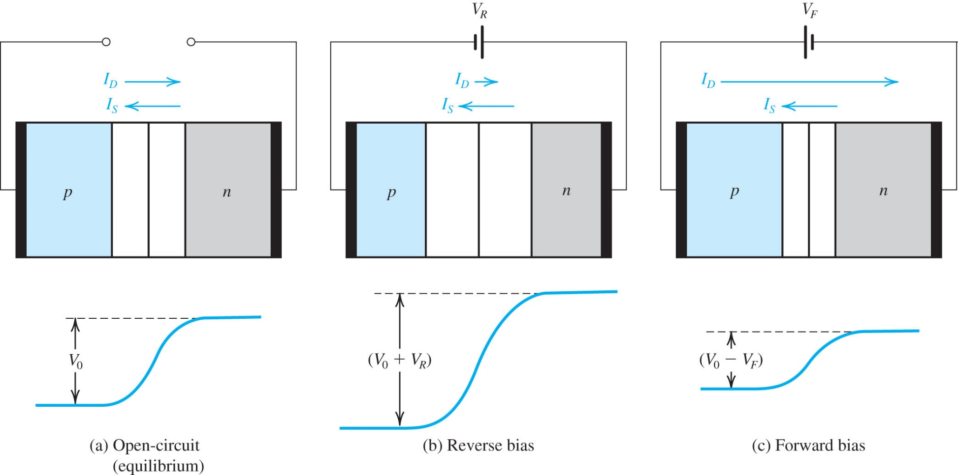
Figure 3.11 The pn junction in: (a) equilibrium; (b) reverse bias; (c) forward bias.

Slide 11
