Slide 1
4-H County
Contests
2023-2024 Overview

Slide 2
Background
Why do we do demonstrations, and why are they a very important part of the 4‐H Program?
Develop life skills
Leadership development
Self esteem / self confidence
A 4-H Presentation helps you learn to:
Research a subject
Organize ideas in a logical order
Share with others
Practice presenting to an audience

Slide 4
4-H Food Contests

Slide 5
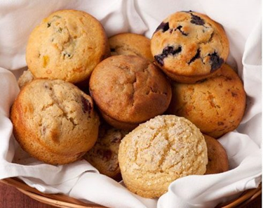
Gallatin County 4-H Better Batter Baking Contest
Who: 4-H Members ages 8-18
When: Saturday, February 10th, 2024 (morning)
Where: Herrick Hall (MSU)
Theme: TBD

Slide 6
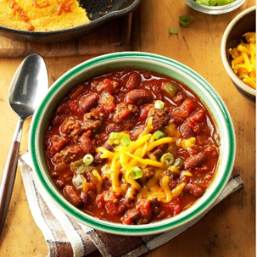
Gallatin County 4-H Stir-Ups Cooking Competition
Who: 4-H Members ages 8-18
When: Saturday, February 10th, 2024 (afternoon)
Where: Herrick Hall Cooking Lab (MSU)
Theme: TBD

Slide 7
Food Contest Guidelines
Objective:
Contestants will prepare a dish that is visually appealing, nutritious and shows creativity. Contestants should use effective work habits and sanitary food preparation practices.
Time Frame:
Meal preparation and cleanup: up to 60 minutes
Presentation/Taste-Testing/Interview: up to 15 minutes
Ingredients:
Contestants will be responsible for all food and supplies needed in their dish. This includes main ingredients (ex. beans, meat, sauces, cheeses), spices/herbs and any other additional ingredients or toppings.
Contestants must bring ALL materials needed to make their dish in order to compete (ingredients, bowls, cutting board, pots, pans, mixers, utensils for cutting, mixing etc.)
*No pre‐preparation of the meal is acceptable (i.e. cutting meat, chopping and washing vegetables, etc.). All work is to be done by the contestants the day of the contest in front of the judges.

Slide 8
Food Contest Guidelines
Judging/Presentation:
You are making one dish that will be done and prepared at the contest and presented on one plate for the judges to taste.
Contestant(s) will present an oral presentation to judges. Oral presentation should address proper table setting; selection of dish; preparation process; nutritional value of dish; and overall learning. Judges will taste the dish and ask more questions about your dish during/after the presentation.
Tips & Tricks:
Please bring a copy of your recipe for yourself and each of the three judges.
Understand the nutritional value of your meal (Serving size, calories, fat, sugar, sodium, etc) What did you learn about the nutrition of your meal?
Dress appropriate for cooking: apron, hair back (if-applicable) and you will interview in this same attire.
Bring a plate to present your dish on to the judges as well as a basic (and correct) place setting: silverware, glass, napkin, etc.

Slide 9
4-H Communications Day Contests

Slide 10
Gallatin County 4-H Communications Day Contests
Who: 4-H Members ages 5-18
When: Saturday, February 24th, 2024 (all day)
Where: TBD

Slide 11
Contests Available
Demonstrations & Illustrated Talks
Individual or Team
Speech
Individual only
Career Communications
Individual only
Video
Individual or Team
Promotional Package
Individual or Team
Commercial
Individual or Team

Slide 12
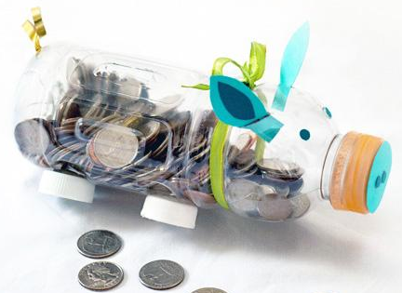
Demonstrations
Member shows how to complete a task the day of the contest
Develop a hands-on, step-by-step process
Utilize visual aids
Results in a finished product
TEAM OPTION: 2 or 3 members work together to deliver the presentation. Each person must share equally in the verbal and visual parts of the presentation. Level of competition is decided by eldest member.

Slide 13
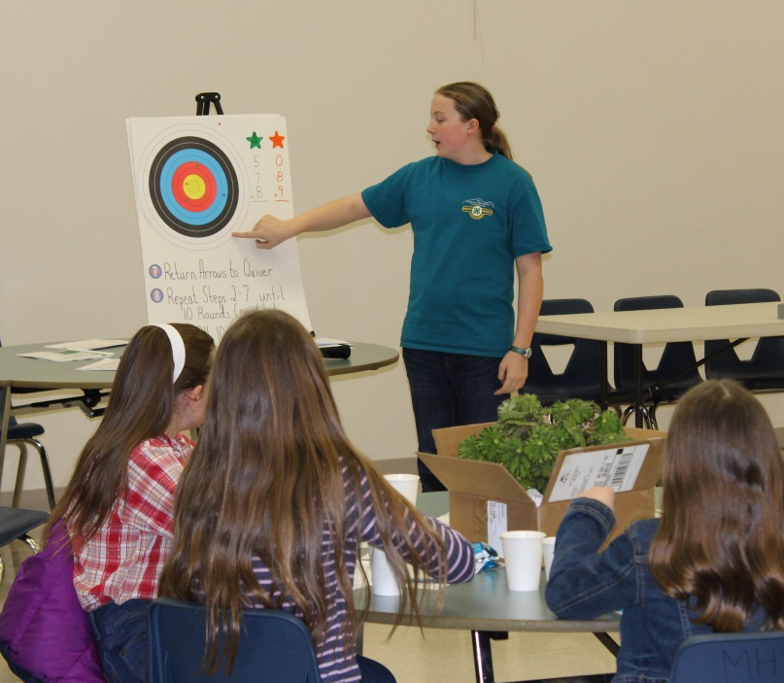
Illustrated Talks
Member (or Team) convey a concept or idea the day of the contest
Utilize visual aids
No end product produced
Time Suggestions
8-10 years old 🡪 3 to 5 minutes
11-13 years old 🡪 5 to 7 minutes
14+ years old 🡪 7 to 20 minutes

Slide 14
Examples

Slide 15
Speeches
Write and communicate an idea, thought or point through the member’s own speech
Can be persuasive or informative
No visual aids
Utilize words, gestures, body language, tone of voice and presenters personal style to convey topic
Time Suggestions
8-13 years old 🡪 3 to 5 minutes
14+ years old 🡪 5 to 7 minutes

Slide 16
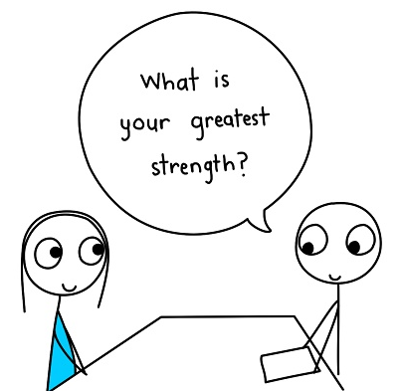
Career Communications
Prepare and submit information prior to the contest day in response to an age-appropriate job posting provided by the 4-H office
(i.e. retail assistant, babysitting, dog sitting)
Complete Application
Draft Letters and Resumes detailing current skills
Day of the contest - Interview for the Job
Wear proper attire
Keep good posture
Eye contact with interviewers
Answer questions as completely as you can
Prepare to ask questions of your own
Thank the interviewer for the opportunity

Slide 17
Career Communications
Senior Members Position Example:
VETERINARIAN ASSISTANT - include providing food and water for animals; bathing and exercising animals; disinfecting feed bowls, cages, kennels, and examination rooms; checking in and discharging animals; and assisting the veterinarian with examinations.
YOUTH SPORTS ASSISTANT - Duties will include setting up class equipment, helping with registration and class check-in, and assisting the coaches with class activities.
Intermediate Members Position Example:
SMOOTHIE MAKER - will prepare smoothies following established recipes or to the customer’s order. They will keep a clean and organized workplace.
PRESCHOOL TEACHER HELPER - duties include help with preparing craft supplies and assisting preschoolers with making the crafts; organizing and cleaning the classrooms; teaching and playing games with preschool students; and assisting teachers with the daily classroom activities.
Junior Members Position Example:
LEAF REMOVER - assist in collecting leaves and sorting by types. Information and training will be provided for sorting and drying. Some horticulture knowledge or willingness to learn about trees and their leaves is a plus
PET FEEDER - assist in preparing the food, feeding the correct amount of food, keeping inventory of feeds, observing general animal health, and reporting any problems to the manager.

Slide 18
Video
Create a message using a video you (or a team) made
Video may be:
Demonstration
Concept or thought
Idea to promote
Final product should be 30 seconds to 5 minutes in length.
Share the information digitally the day of contest
Member (or Team) interview to discuss the video’s points, intended audience and effectiveness.
Utilize the 4-H Movie Magic project book for tips (published by MSU Extension in April 2011)
https://4-h.org/parents/curriculum/filmmaking/

Slide 19
Video
All videography and editing must be done by the contestant(s) and content must be 4-H appropriate.
Follow all copyright laws regarding music and images. Have credits depicting participants and their roles.
Contestant can choose music, video production methods, and final format:
Footage
Still photography
Computer animation
Stop motion
Consult with parents and/or adult leaders regarding safety when making the video or posting the final product online.

Slide 20
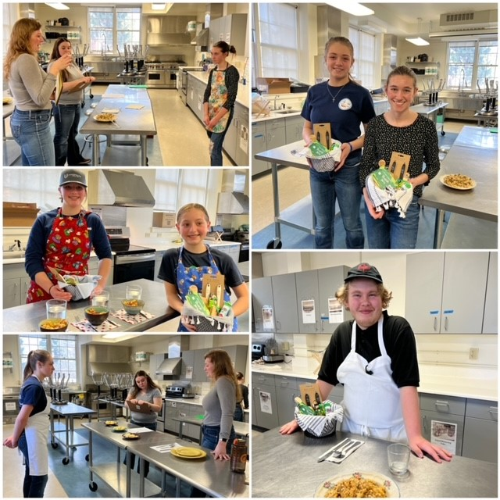
Why Participate?
The experience 4-H youth members receive from this event is tremendous.
Become more confident
Practice communication skills
Discover where they can improve
Gain experience presenting to a small panel of adult judges
Meet other 4-H members
Have FUN!

Slide 21
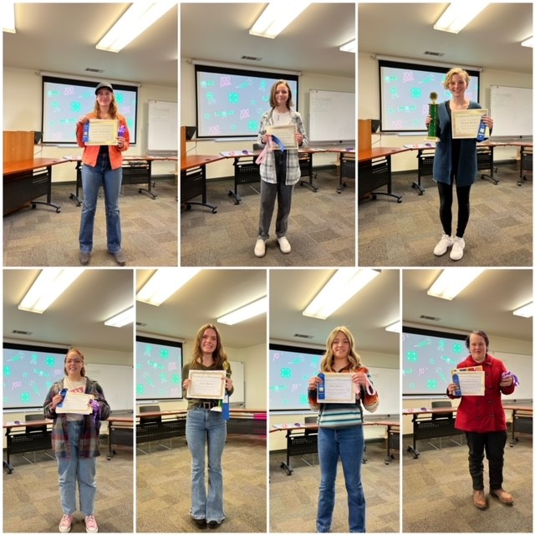
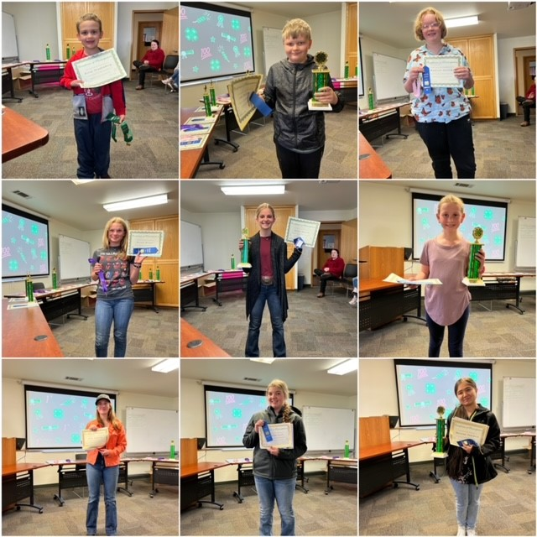
Winners Circle
County Contest Awards Night – Date TBD
ALL youth participants are invited to be recognized for their participation and efforts. Winners in each contest and age division will receive certificates and prizes. All contestants receive a goody bag on the day of the contest as a thank you for participating!

Slide 22
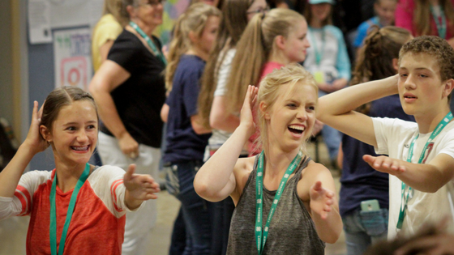
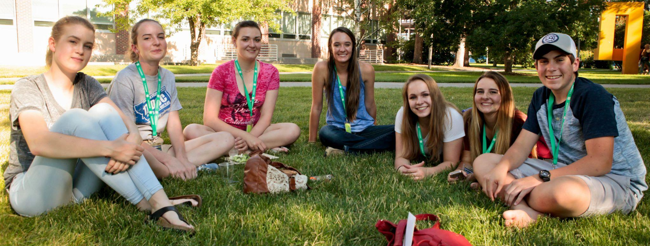
State 4-H Congress
Youth ages 14+ whom receive a blue ribbon or higher at the County Level Competition may advance to the
State Competition mid-July at the MSU Campus!
Montana 4-H Congress provides youth from across the state an opportunity to come together and participate in an event like no other.

Slide 23
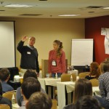
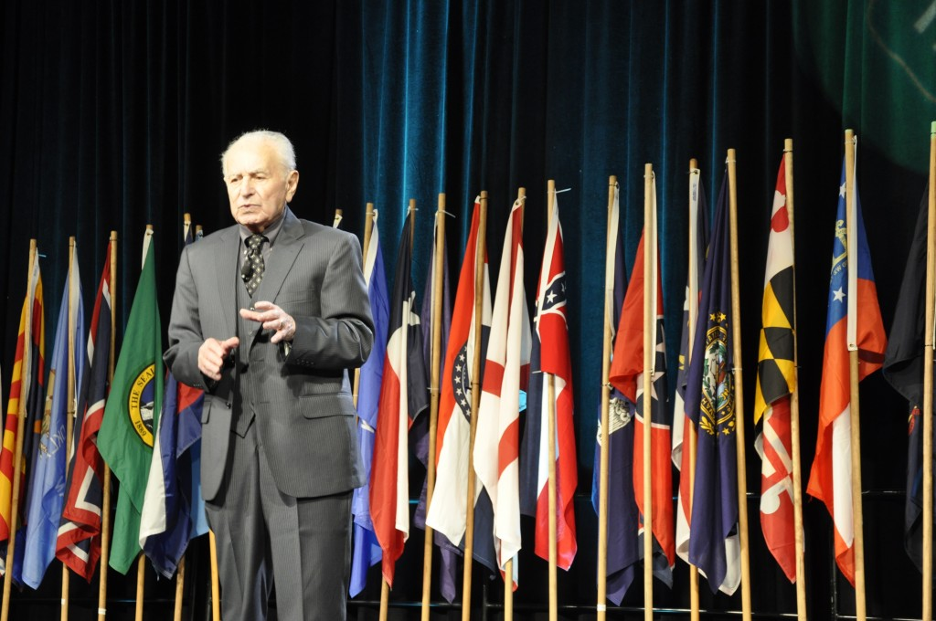
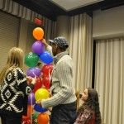
National Opportunities
4-Hers who win a State Award or a State Contest, are invited to attend National Congress in Atlanta, Georgia at Thanksgiving.
Delegates spend a week in Atlanta attending leadership and citizenship workshops as well as participating in community service activities.

Slide 24
Questions?
Event Registration on ZSuite Events tab
Email gallatin4h@montana.edu with any questions

